Slide 1

“Mood Recognition System
In Python"
Vishal Bhardwaj

Slide 2
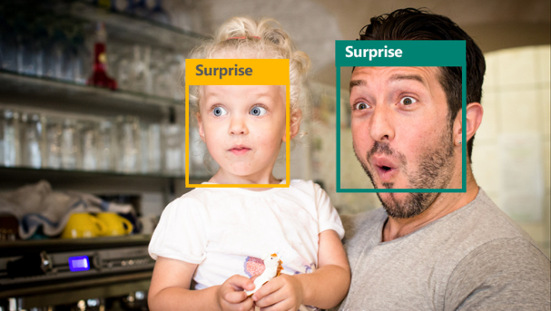
Mood Recognition System In Python
Group Members :- Vishal Bhardwaj (Group Leader)
Nikhil Upadhyay

Slide 3
INTRODUCTION
Our project titled as “Mood Recognition System" is basically a Window Based application used to inform the user and the observer about the emotional conditions of a person as through what phases he/she is passing through.
It is the best medium to know the mood/emotions of a person by recognizing his/her facial expressions. If a person is sad, happy or angry he can know the emotional status and can calm himself down, also allows the observer to monitor the user. There are several other benefits of using the recognizer application.

Slide 4
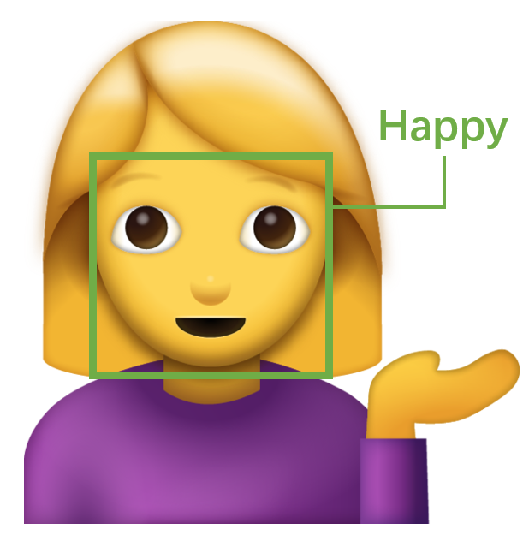
ADVANTAGES OF Mood Recognition System
Available at any time
Improved Recognizing patterns through facial expressions.
Easy Flow of Detecting the face and presenting emotions.
Free availability
Helps the observer in detecting and monitoring human emotion.

Slide 5
REQUIREMENTS
Functional Requirements:-
Expression detection: The user must look into the window being presented so that his/her expression could be recognized.
The system should be able to provide the following mood/emotions as per the facial expression : Happy, Sad, Angry, Surprised, Confused.

Slide 6
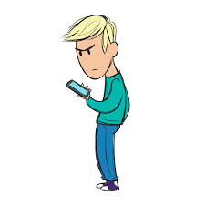
REQUIREMENTS
Non-Functional Requirements:-
The interface gives the response in less than 10seconds.
The system must be secure.
The system should be maintainable so that if any change occur, it does not get effect.
The system should be easy to use for users.

Slide 7
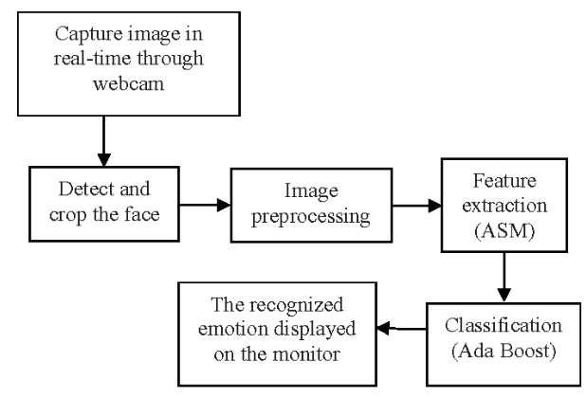
DATA FLOW DIAGRAM (DFD)

Slide 8
GANTT CHART
Procedures | Week 1 | Week 2 | Week 3 | Week 4 | Week 5 | Week 6
Requirement Analysis
Design
Implementation (Coding)
Testing
Maintenance

Slide 9
Thank you

